Slide 1
Wizeline DEB Bootcamp
Capstone Project Presentation

Slide 2




Sidney Ochoki Isoe
Software Implementation Consultant | Business Analyst | Data Analyst
Working with data for over a decade
Music, video games, data
sidneyisoe

Slide 3
Session Goal The goal is to explain my end-to-end solution used for the capstone project.
Introduction
Infrastructure
Data Pipelines
Challenges
Lessons Learned

Slide 4




1. Introduction
The objective of the capstone project was to use the technologies and techniques we acquired during the bootcamp to build an end-to-end solution for movie analytics data warehouse

Slide 5
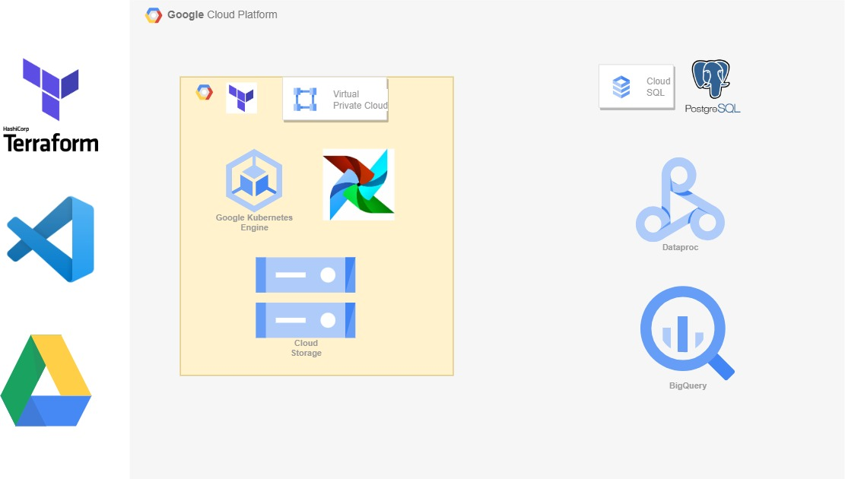
2. Infrastructure

Slide 6
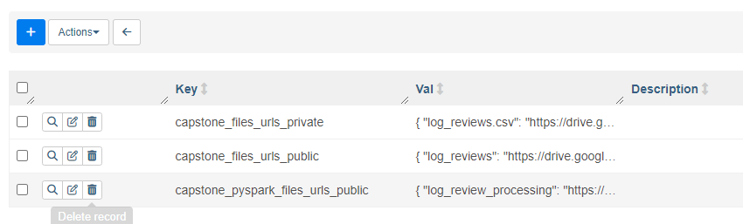
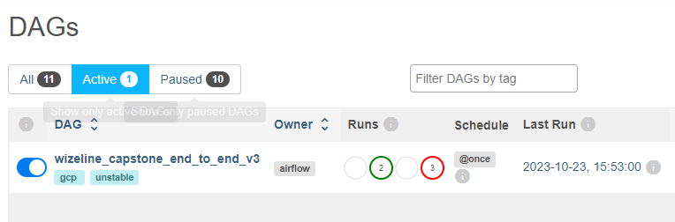
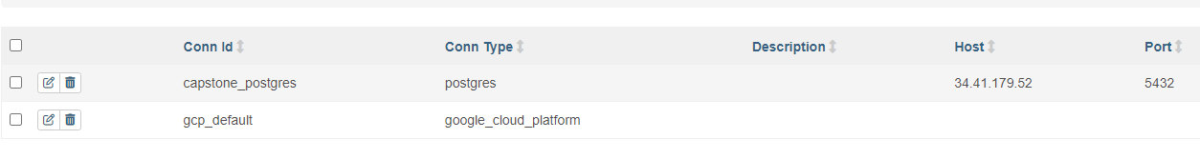
Pipeline
Variables
One end-to-end solution
Connections

Slide 7
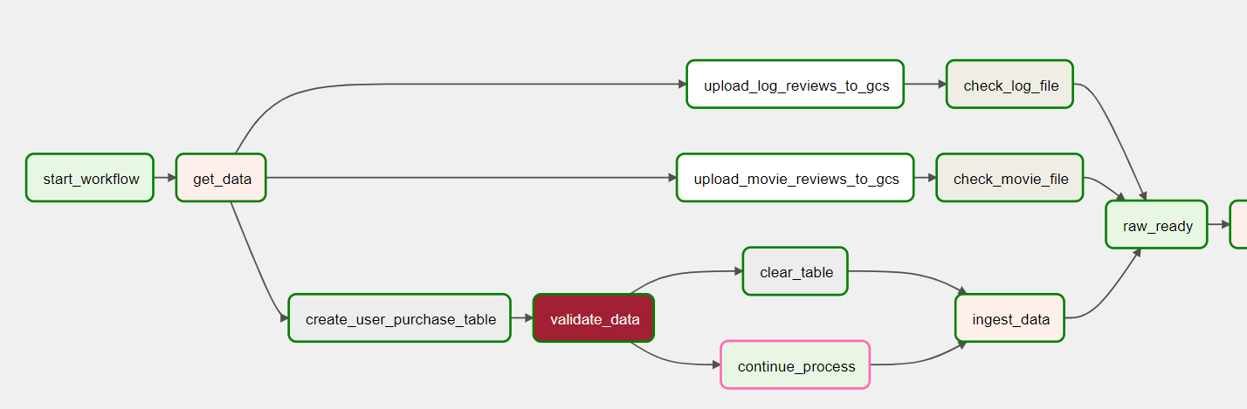


Pipeline – load data to RAW
Data Ingestion
user_purchase.csv file into a PostgreSQL DB
the last two CSV files (movie_review.csv and log_reviews.csv) into a cloud bucket

Slide 8
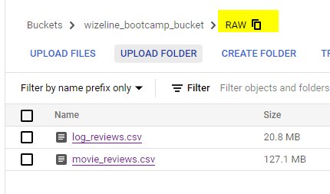
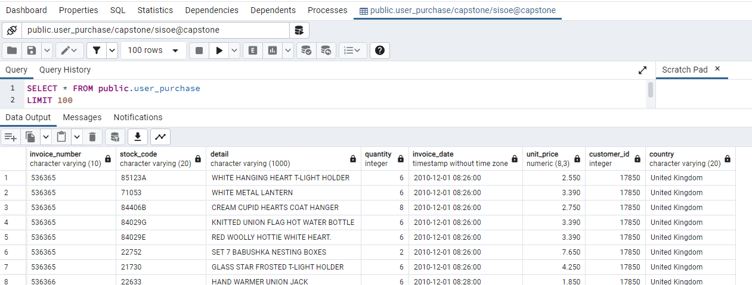
Pipelines – ingested data

Slide 9
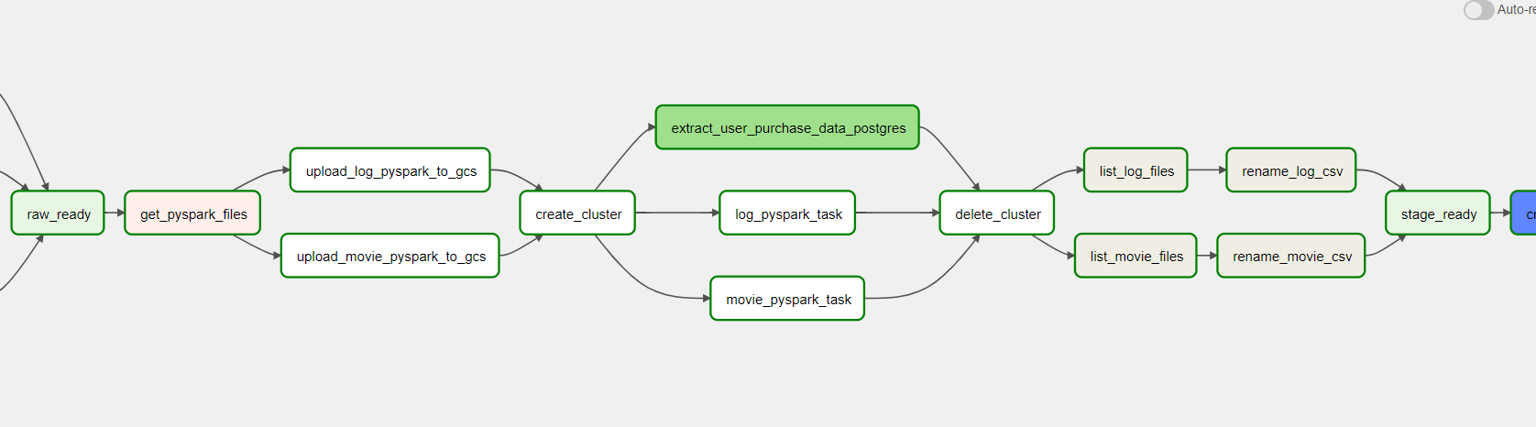

Pipelines – RAW to STAGING
Transforming the data by submitting a PySpark job in Dataproc
Extracting the user_purchase data from postgres
Combining the part files from Spark into single csv files

Slide 10
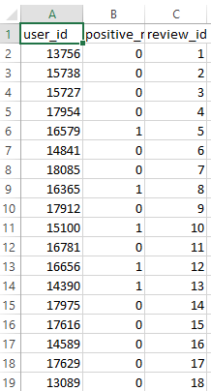
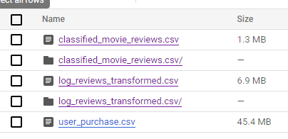
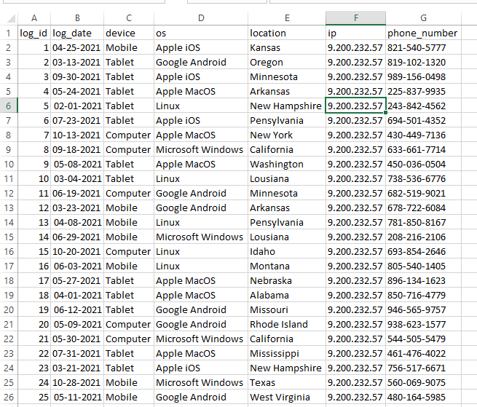
Pipelines – RAW to STAGE
classified_movie_review.csv
STAGE bucket
Review_logs.csv

Slide 11
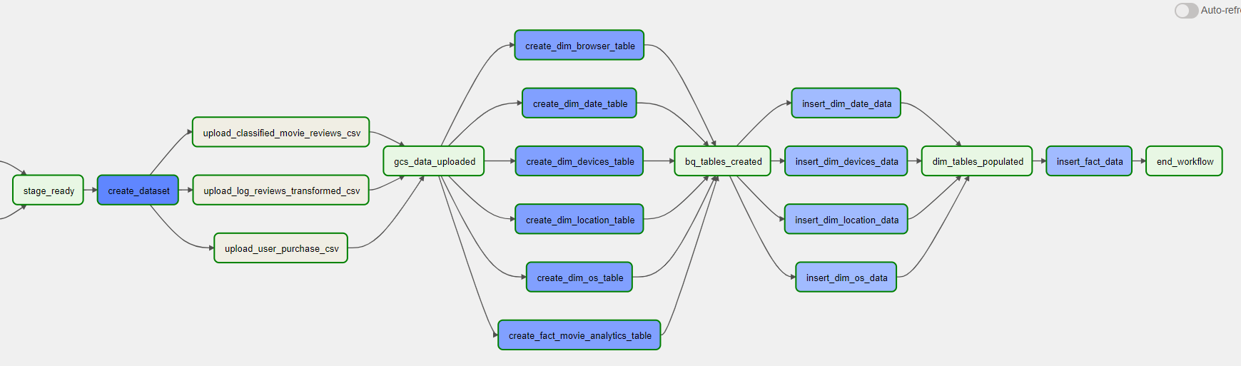

Pipelines – STAGING to Data Warehouse
Created a Data Warehouse structure for an external analytics team to be able to consume Data Warehouse entities.
Inserted data from the STAGING data into an appropriate star schema

Slide 12
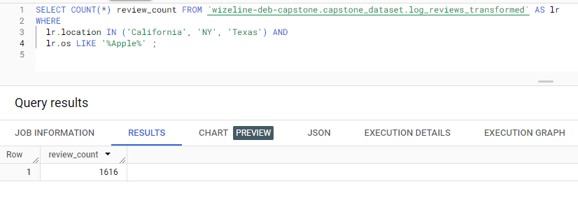
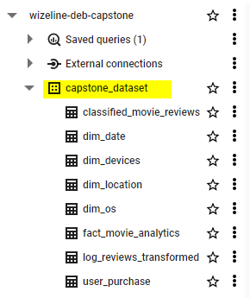
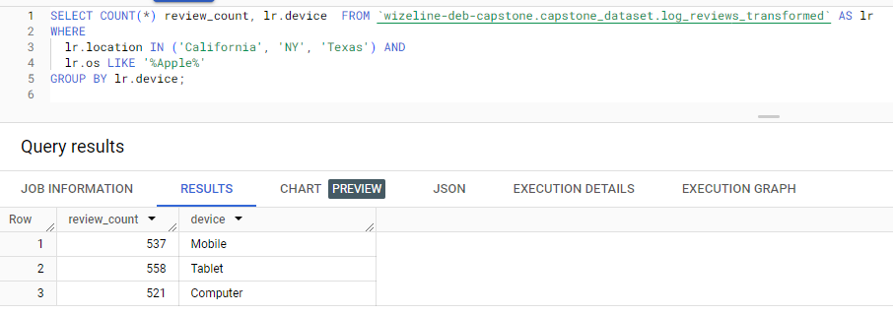
BigQuery (DW) - Analytics

Slide 13
Challenges: TIME & INFRASTRUCTURE
Building the infrastructure using terraform
Understanding GCP
Endless errors
Inadequate Airflow documentation

Slide 14
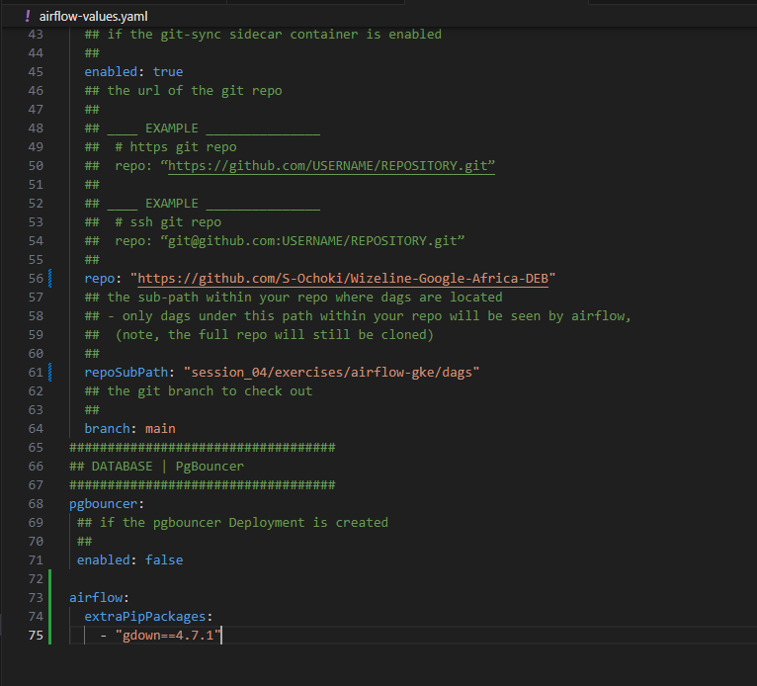
Challenges: Navigating GKE

Slide 15
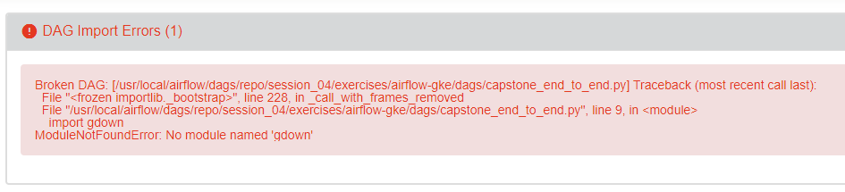
Challenges: DAG Errors

Slide 16
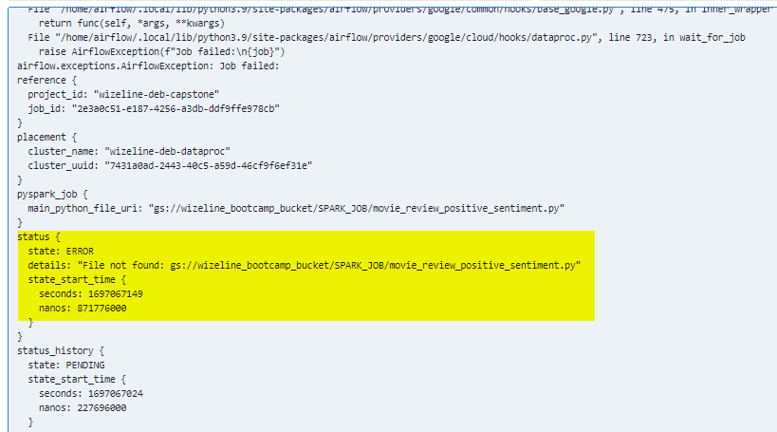
Challenges: Infrastructure knowledge
inaccurate file creation / storage

Slide 17
Lessons Learned
Airflow
IaC / Terraform
Cloud vs On-premise
Data storage options
Data processing

Slide 18

Summary
It was a very good experience

